Slide 1

Committee on Earth Observation Satellites
CB activities in EO at ESA
ESA
F.Sarti
Day 1- Item 9
CEOS 6th Working Group for Capacity Building and Data Democracy (WGCapD)-6 Annual Meeting, DLR Oberpfaffenhofen, Germany
27th-29th March, 2017

Slide 2
Who do we target
Young professionals dealing with geoinformation
PhD and university students
Secondary schools
General public and decision-makers

Slide 3
ESA partners in CB, Education & Training activities – Earth Observation
In Europe
Universities and public institutes in Europe (mainly ESA member states and ECS) and other Space Agencies
European associations with an educational mandate like: Earsel, EGU/GIFT
In the frame of International Cooperation outside Europe
3. CEOS WGCapD, UN (UNOOSA, FAO, UNESCO..)
4. Space Agencies worldwide
5. International associations with an educational mandate like: SELPER, COSPAR
6. Africa: TIGER Programme
7. China: DRAGON Programme
8. Countries in Africa and South America cooperating with ESA
9. Development Banks

Slide 4
(1) ESA ESERO project (European Space Education Resource Offices in ESA MS) – secondary school level
Target: European students starting from an early age (primary and secondary education)
Goal: using the space context to make the teaching and learning of STEM subjects more attractive
ESERO offers an annual series of national or regional training sessions for both primary and secondary school teachers, offered in collaboration with national partners
Presently located in:
Austria: Ars Electronica Center in Linz
Belgium: Planetarium of the Royal Observatory of Belgium in Brussels
Czech Republic: Prague, with Charles University of Prague and others
UK: based at the National STEM Centre in York
Ireland: Dublin, with the Science Foundation Ireland
Netherlands: at the Nemo Science Learning Centre in Amsterdam,
Nordic ESERO: Denmark, Finland, Sweden and Norway (based at NAROM), Poland: in the Copernicus Science Centre in Warsaw,
Portugal: in the Knowledge Pavilion, Lisbon,
Romania: based in the Romanian Space Agency
New ESEROs in preparation:
Germany
Hungary
Italy
Greece
Spain

Slide 5
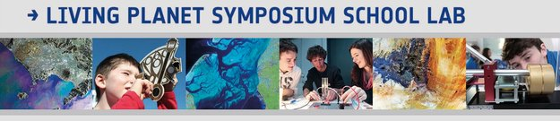
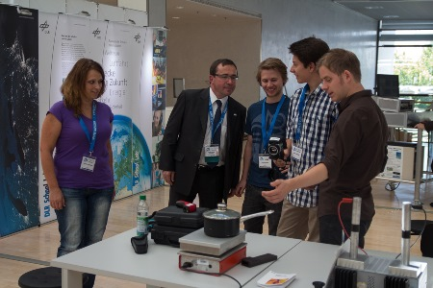
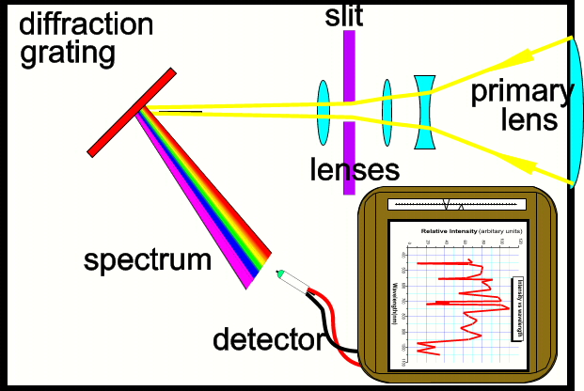
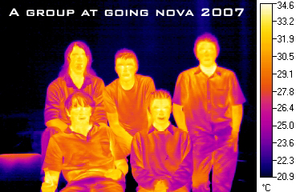
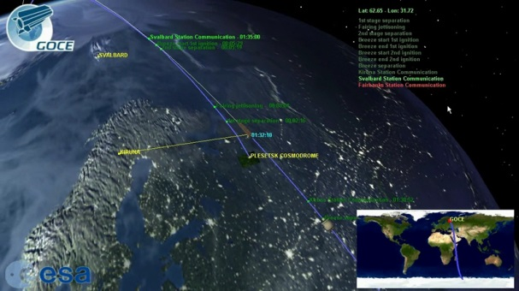
(1) Education in the frame of European cooperation – secondary school level
Creation of joint School Labs with ESA, DLR, UK National Space Academy, Charles University.
  Such as during IGARSS 2012, LP Symposium 2013 and LP Symposium in May 2016. Demonstrating RS to schools using instruments such as: Field Spectrometer, Thermal camera, UV light, Stereo Optical Camera, possibly enriched by many other experiments and 3D / oculus technology

Slide 6
(1) Training courses at University level in Europe
SAR Remote Sensing Training courses in ECS countries, 1-2 per year
Training courses about RS theory and applications (Land, Atmosphere, Ocean) in European countries (rotation mechanism), yearly basis
Summer Schools (RS Data Assimilation) in ESRIN for University and PhD level (every 2 years)

Slide 7
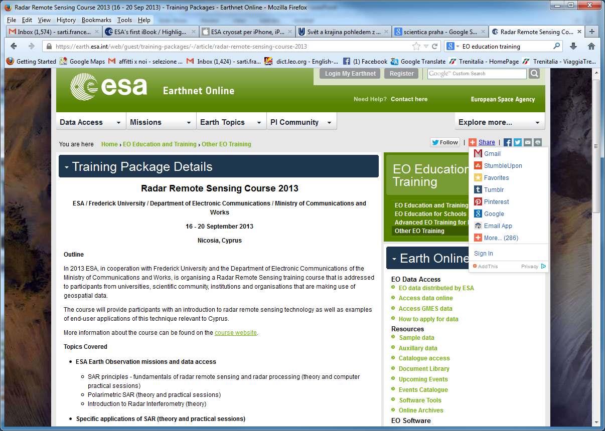
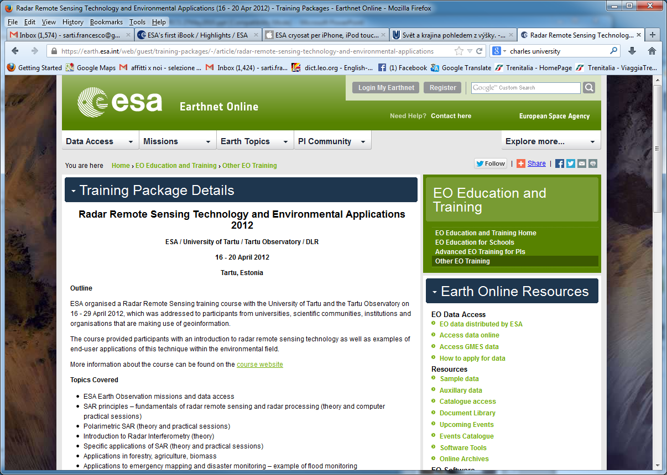
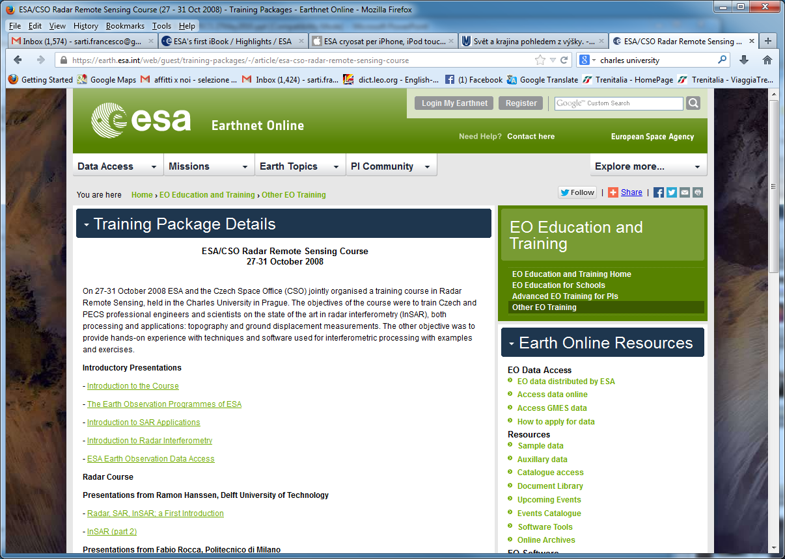
(1) Radar training courses in ECS
Series of Radar Training Courses in ECS countries since 2008 (Univ. level)
Czech Republic (2008), Romania (2009), Poland (2010), Hungary (2011), Estonia (2012), Cyprus (2013), Malta (2014), Slovenia (2015), Bulgaria (May 2016) and Latvia (Sept 2016), Lithuania (July 2017)

Slide 8

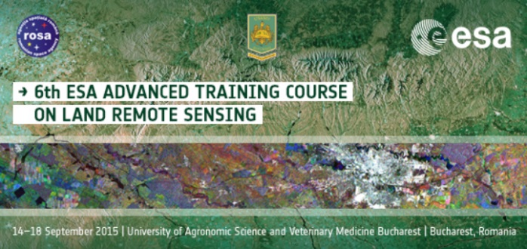
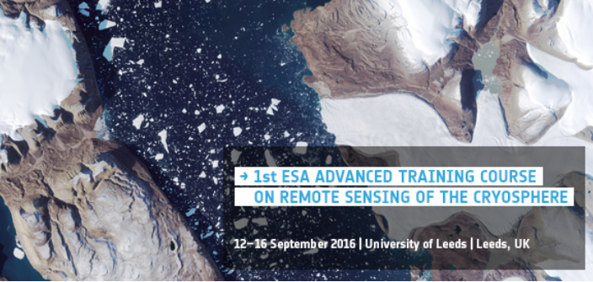
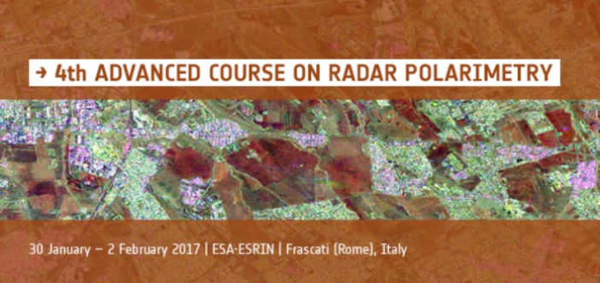
(1) Innovative Training for
Next generation EO Scientists
Objectives
Training the next generation of European and Canadian investigators
Teaching and demonstrating theoretical principles, processing algorithms, data products and their use in applications
Introducing tools and methods for the scientific exploitation of EO satellite data
Stimulating and supporting the scientific exploitation of ESA EO and Third Party operational missions

Slide 9
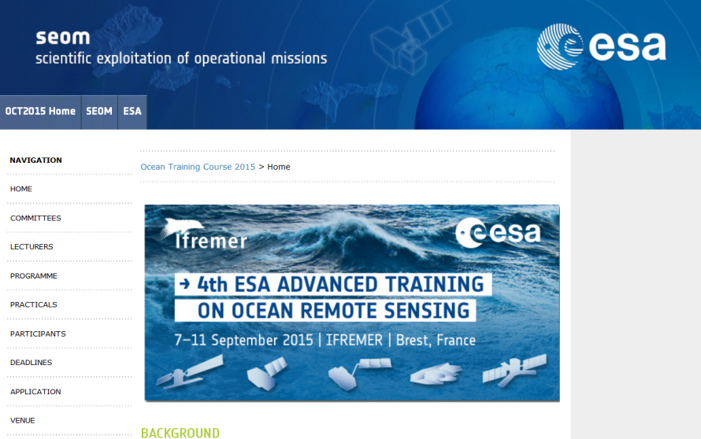
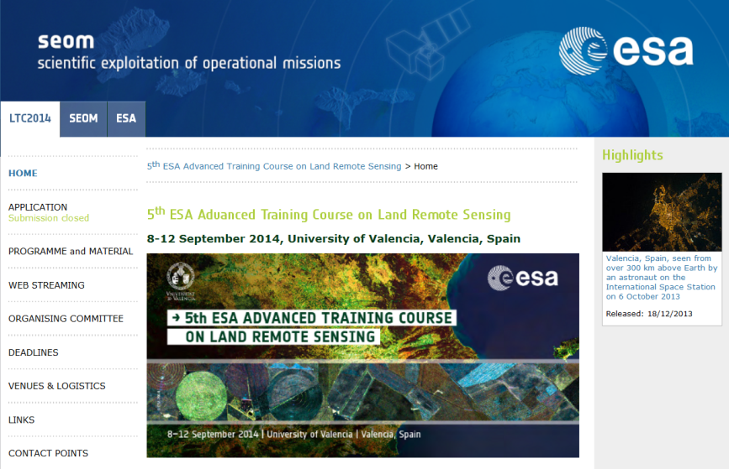
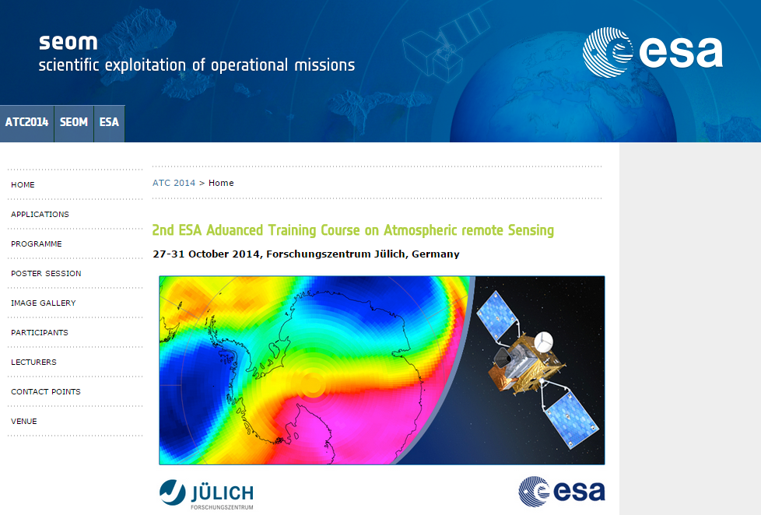
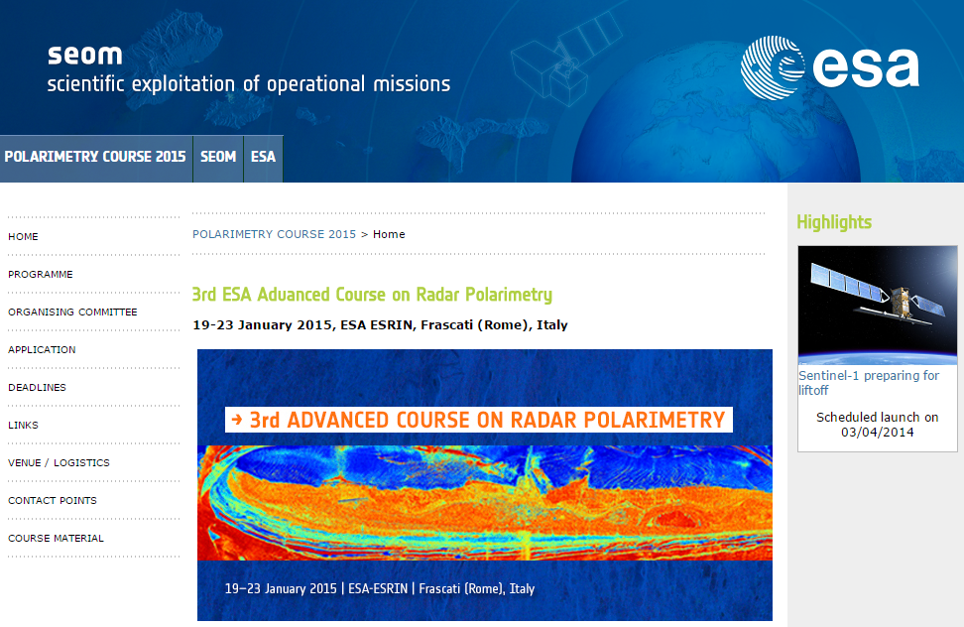
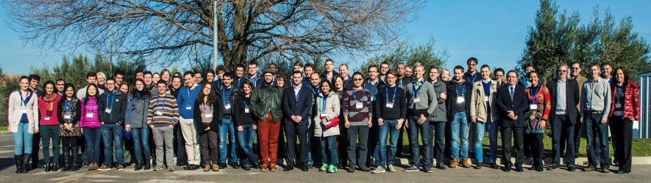
Previous Advanced Training Courses
(1) Innovative Training for
Next generation EO Scientists
Ocean
France, Sep 2015
Land
Spain, Sep 2014
Atmosphere
Germany, Oct 2014
Polarimetry
Italy, Jan 2015

Slide 10

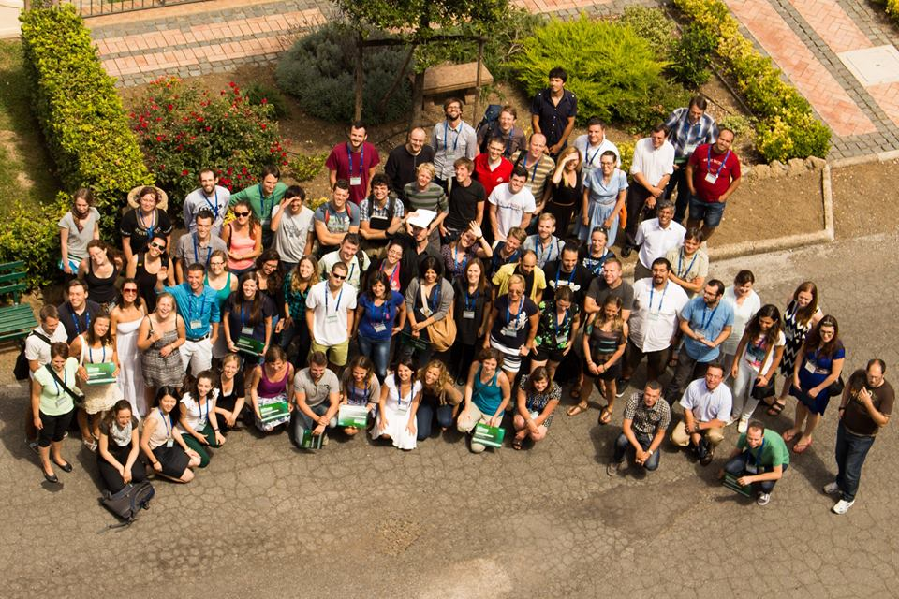
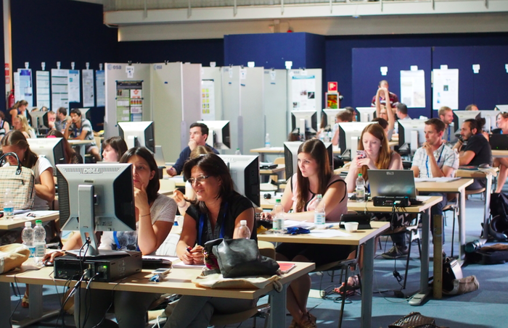
(1) Earth Observation Summer Schools
1-12 August 2016 Summer School ESRIN
70 early career scientists
have taken part.
Usually organized every 2 years, open to students from worldwide, free tuition
Topics :
Global Observing Systems, Earth System Modelling, Data Assimilation, Global Change

Slide 11
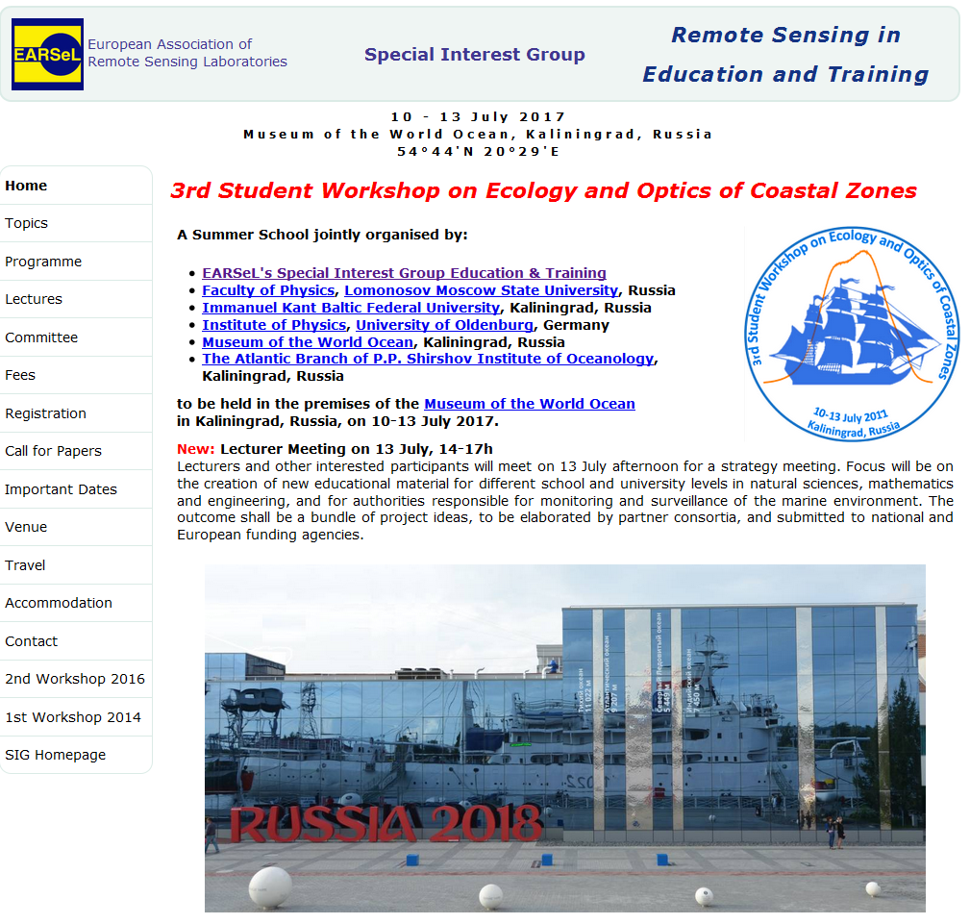
(2) Training & Education in the frame of European Cooperation: Earsel network
Long-term cooperation in organising joint Workshops for Secondary School teachers with Earsel (European Association of Remote Sensing Laboratories)
Recent Earsel Workshop and Trainings: Bonn (June 2016), Bejing (July 2016) and Frascati(Rome)/ESRIN on RS for Archaeology (November 2015)
Upcoming event:
3rd Student Workshop on Ecology and Optics of the Coastal Zones (10-13 July 2017, Kaliningrad, Russia)

Slide 12
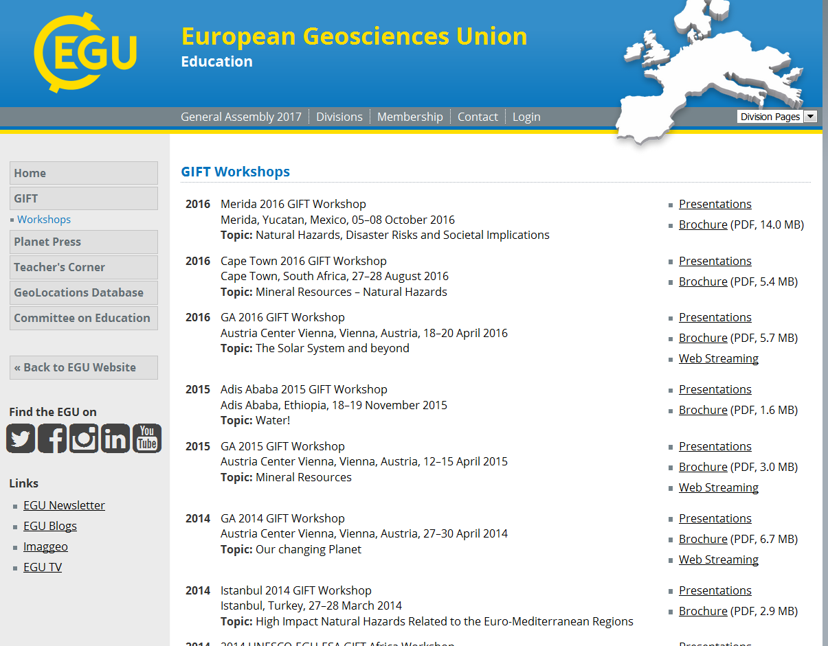

(2) Education in the frame of European Cooperation: EGU/GIFT network
7-years cooperation with EGU/GIFT (European Geosciences Union
GIFT – Geosciences Information for Teachers). Recently enlarged to Africa and South America (2016 events in Merida Mexico and Cape Town).
Workshops for Secondary School teachers selected worldwide

Slide 13
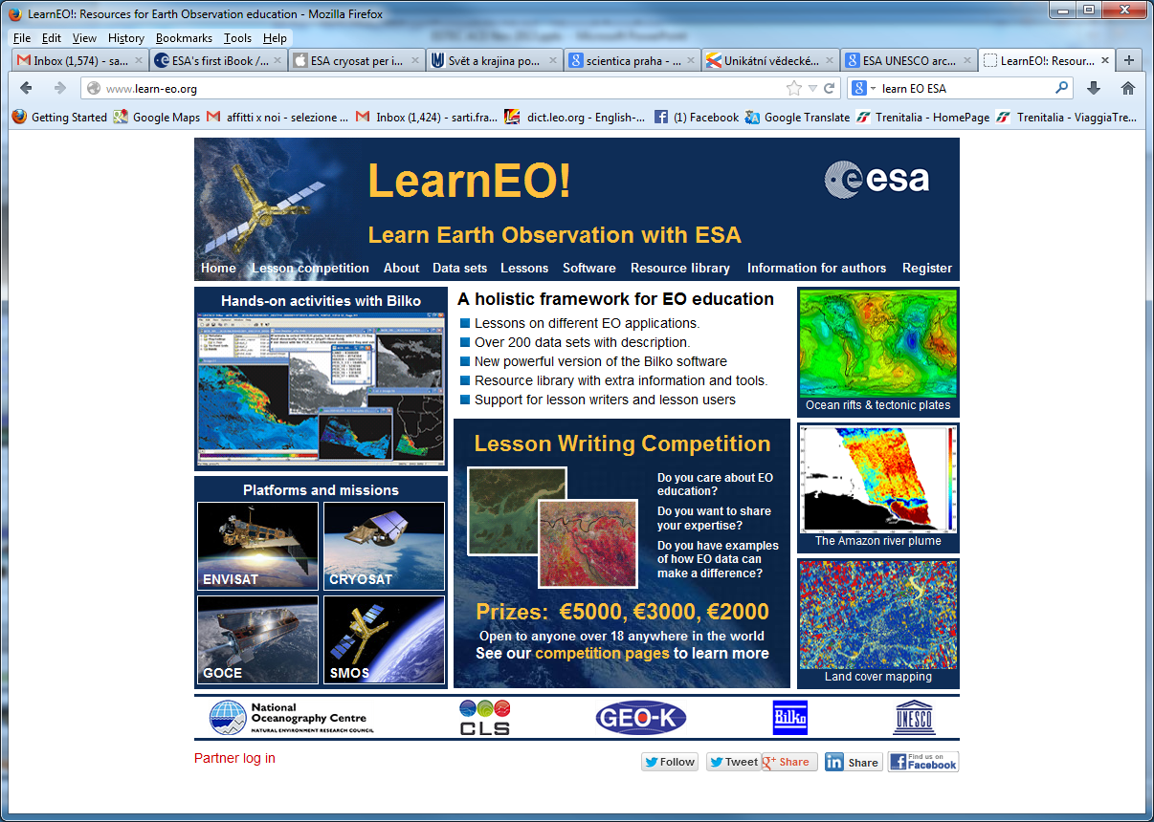
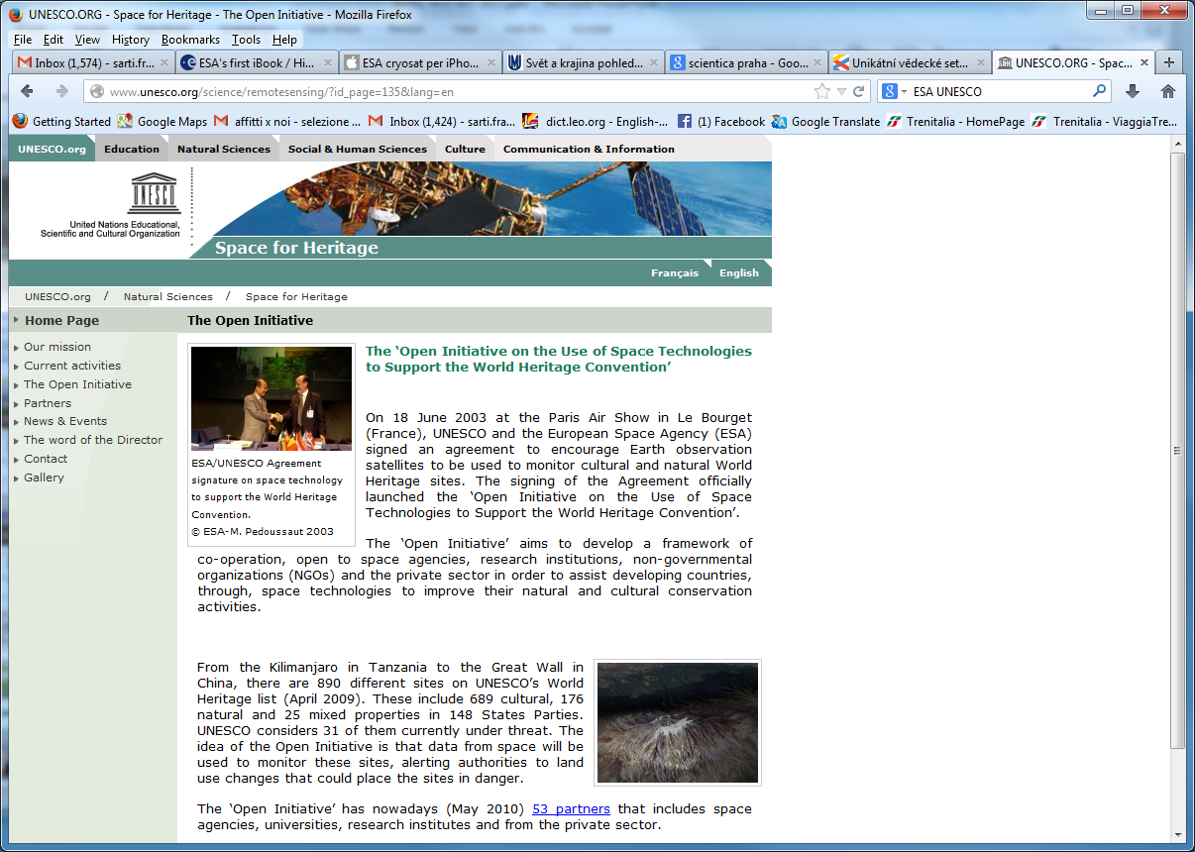
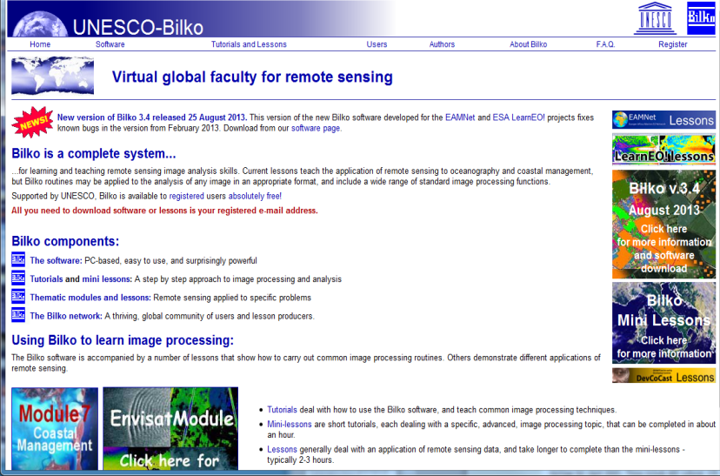
(3) Capacity Building in the frame of International Cooperation with UNESCO

Slide 14
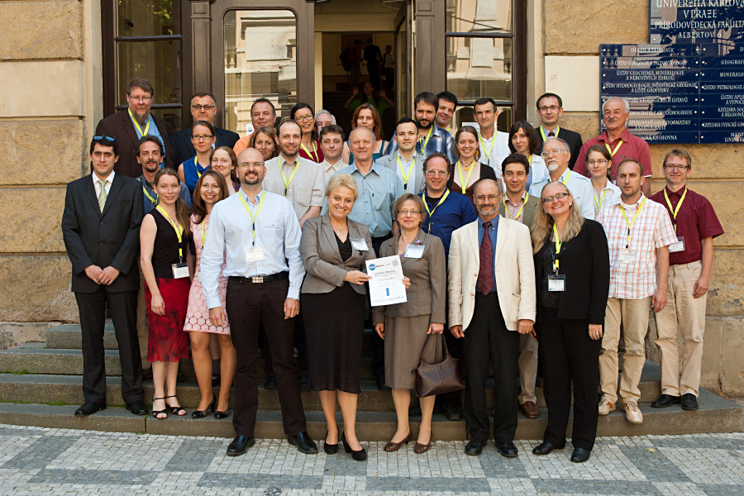
(4) Capacity Building in the frame of International Cooperation with other space agencies
Examples: Cooperation with NASA (Trans-Atlantic Training on LULC in Baltic Countries and Eastern Europe). Forthcoming TAT training event in Hungary, June 2017.
See TAT http://web.natur.cuni.cz/gis/tat/
LCLUC workshop http://www.nyme.hu/lcluc_training.html?&L=4
      https://web.natur.cuni.cz/gis/lucc/

Slide 15
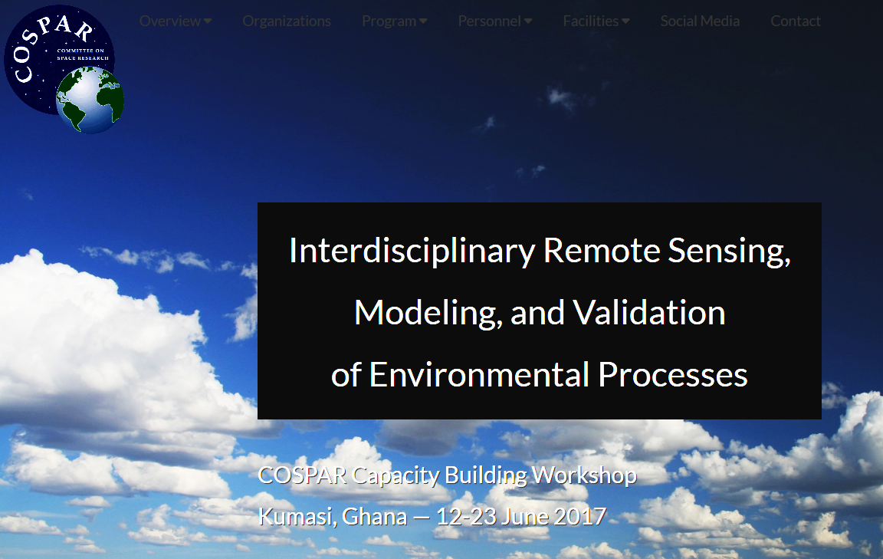
(5) Cooperation with COSPAR
ESA traditionally supports and contributes also to COSPAR training courses (https://feer.gsfc.nasa.gov/meetings/COSPAR2017/)
COSPAR CB Workshop, Ghana, June 2017

Slide 16

(6) International cooperation with Africa
African Community:
TIGER involves more than 150 African Institutions in 42 countries who actively participate in TIGER development projects and capacity building actions (EO for hydrology applications)
http://www.tiger.esa.int/page_training_news.php

Slide 17
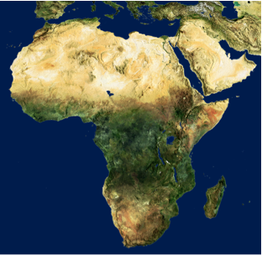
(6) The TIGER Initiative:
Example - Hydrological Community
ESA launched TIGER in 2002 as a CEOS response to World Summit on Sustainable Development in Johannesburg.
TIGER objective:
“assist African countries to overcome problems faced in the collection, analysis and dissemination of water related geo-information by exploiting the advantages of Earth Observation technology”.
African Community:
TIGER involves more than 150 African Institutions in 42 countries who actively participate in TIGER development projects and capacity building actions (EO for hydrology applications)
Notes:
Investment of 11 Mio euro total budget
Reaching more than 150 African water authorities and research institutes

Slide 18
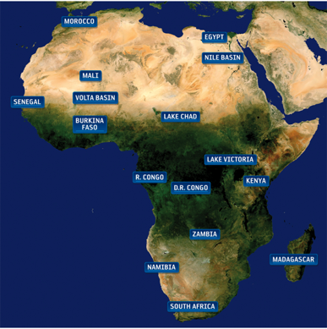
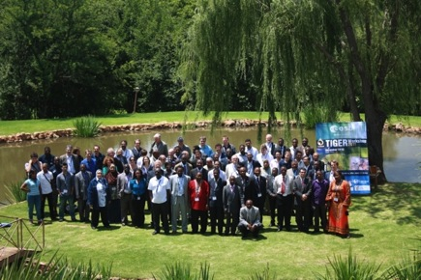
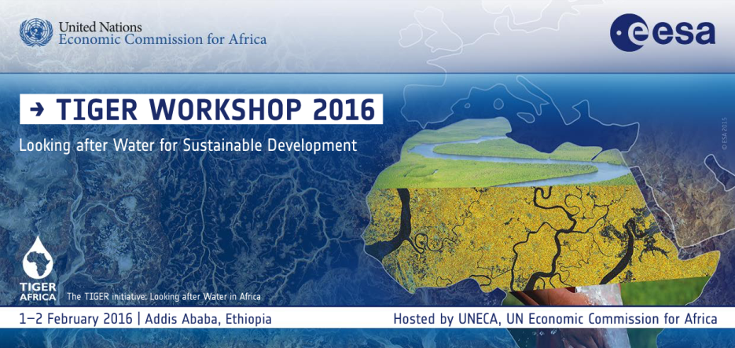
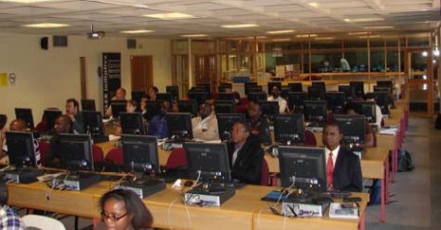
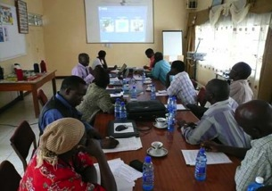
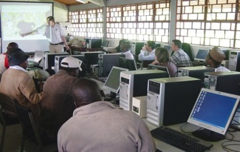
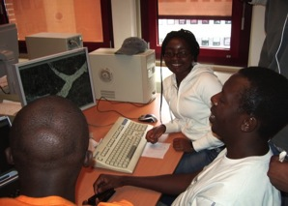
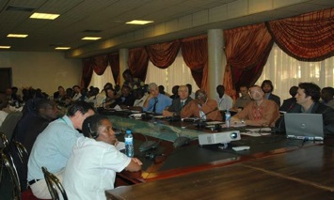
(6) TIGER Capacity Building Facility (TCBF):
Developing African Knowledge and Scientific Capacity
Training Activities:
  Dedicated Training courses in Africa & Europe
  Empowerment of Regional Centres: AGHRYMET (Niger), RCMRD (Kenya), SANSA (South Africa); OSS (Tunisia)
  Partnership with UNDP Cap-Net for Training of Trainers
Water Research Component
  Support to many research projects in Africa
  Tailored technical support and research stages;

Slide 19

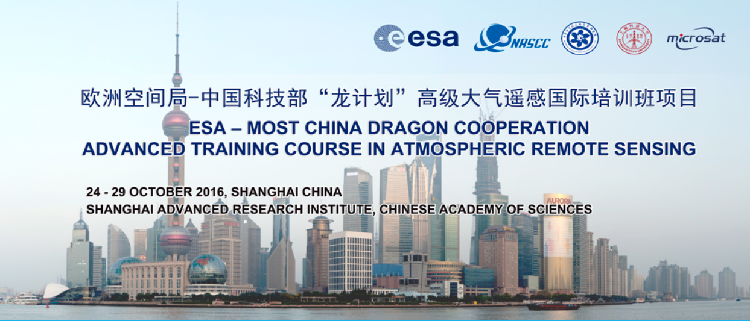
(7) International cooperation with China
DRAGON Training Courses

Slide 20


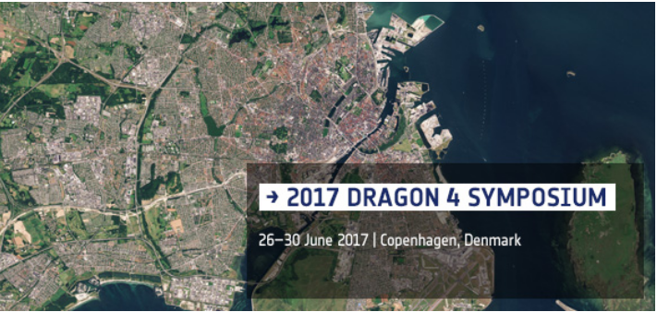
(7) Recent and upcoming DRAGON CB events
Upcoming event:
DRAGON 4 Symposium, 26-30 June 2017, Copenhagen, Denmark

Slide 21
(8) Priorities of ESA External Relations in Africa and South America
Africa:
South Africa
Kenya, Gabon (ESA ground stations)
South America:
Argentina, Brazil
Mexico, Chile

Slide 22
Sentinel Training with the European Commission
New approach: upcoming Sentinel training with R.U.S. / European Commission.
Possible opening to African and South American users

Slide 23
(9) CB in the context of cooperation with development banks
eotap – twelve Earth Observation projects supporting Asian Development Bank activities (2014-2016) in Uzbekistan, Armenia, Mongolia, Tongo, Timor-Leste, Papua New Guinea and many more. As a part of each project workshop/capacity building events were carried out.
eoworld – 18 contracts carried out in support of World Bank projects (2014-2016) in South America, Africa and Asia. All the projects support capacity development.
EO4SD (Earth Observation for Sustainable Development) – new initiative carried out with International Financing Institutions for the years 2016-2018

Slide 24
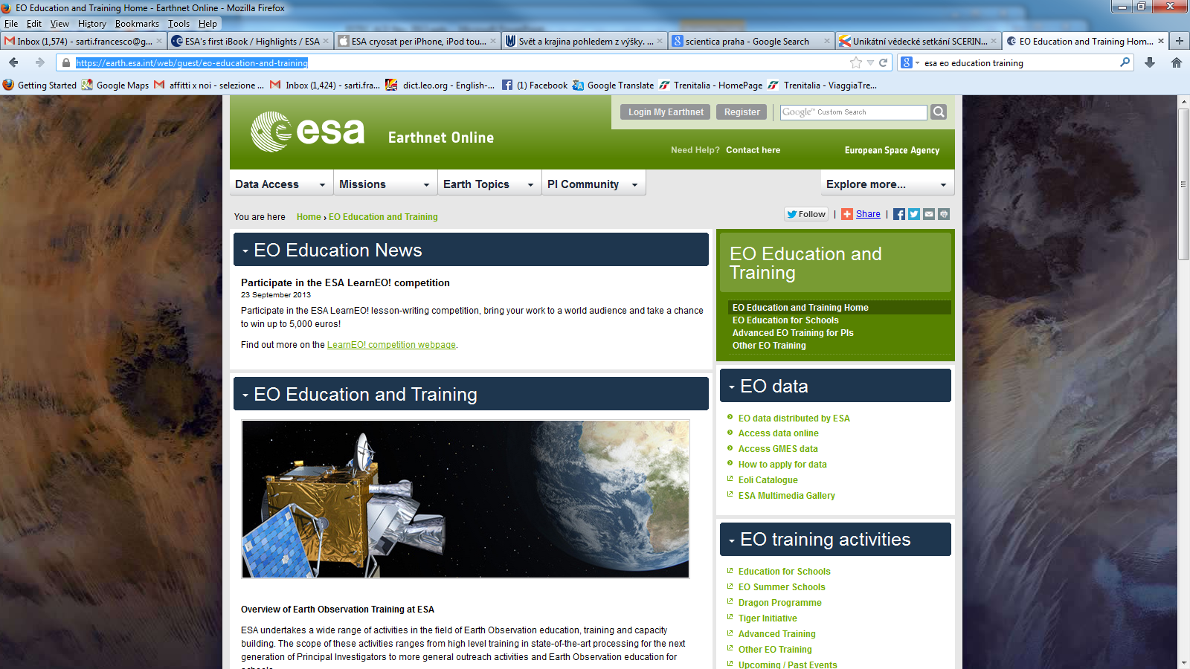
Training courses online - centralized web page
The content of most training courses can be linked from the central web page for ESA EO Education and Training:
https://earth.esa.int/web/guest/eo-education-and-training

Slide 25
CB for Decision-Makers / Policy-Makers
TIGER
Sen2-Agri
GlobWetland Africa
DUE
Food Security
Copernicus (with the Commission)

Slide 26
CB for policy makers: Africa
Recent events in TIGER (that will be repeated in the future):
The TIGER workshop 2016 was held in Addis Ababa hosted by UNECA with 100 participants from 19 African and 10 European countries.
Attending water experts and stakeholders represented 8 African trans-boundary river basin authorities, 10 national water authorities, 9 intergovernmental organizations and 31 R&D institutions
  The event was followed with a training on sentinel data exploitation for
  water management dedicated for stakeholders (ministries and governmental agencies) from different African countries.
  Water Observation and Information System for Flood Monitoring Training (29 October-1 November 2016, Kampala, Uganda)
  The event was targeted for water and environmental specialists with Earth observation background, working in government agencies, catchment management agencies, NGO’s and research institutions.

Slide 27
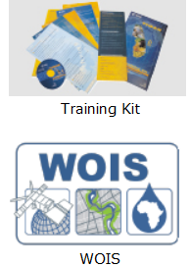
CB for policy makers: Africa
TIGER tools
The open-source Water Observation and Information System (WOIS) aims to enable African water authorities the production and application of a range of satellite earth observation based information products needed for Integrated Water Resource Management (IWRM) in Africa. The WOIS is available freely to any interested user pending a short registration.
To reinforce the TIGER capacity building actions training and education tools have been developed and refined together with the Regional Offices. In particular, a TIGER Training Kit was compiled and is freely available for trainings given by TIGER partners at regional, national or University level.

Slide 28
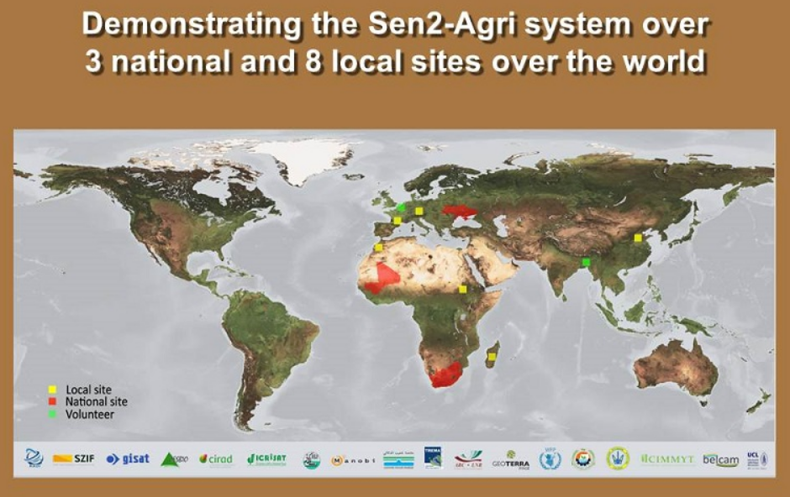
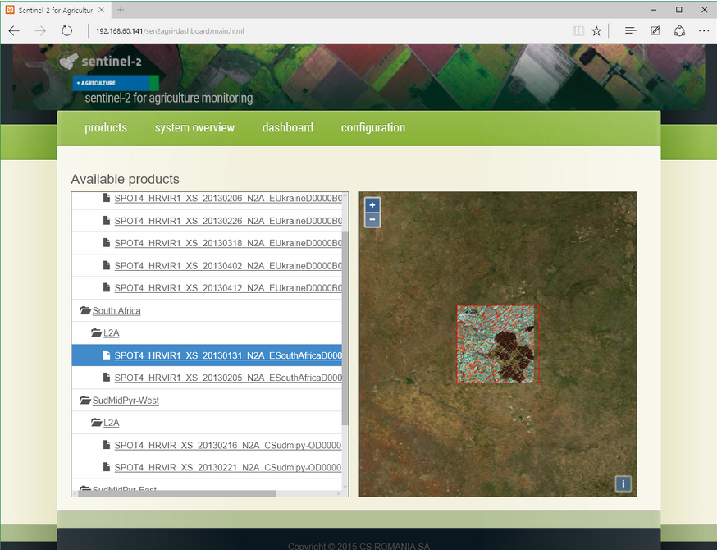
CB for policy makers within ESA projects with developing countries
The Sentinel-2 for Agriculture project Sen2-Agri builds capacity in 3
countries (Mali, South Africa and Ukraine) for national scale agricultural monitoring based on S2 and L8.
The CB includes the installation of a full processing system, software components (Sen2-Agri Toolbox), as well as hands-on training sessions and demonstrations at the national level.

Slide 29
CB for policy makers within ESA projects with developing countries
  The GlobWetland Africa project builds capacity within UN Ramsar secretariat and in national focal points in several African countries
  through regional training events. The goal is to provide African stakeholders with the necessary EO methods and tools to better fulfill their commitments and obligations towards the Ramsar Convention on Wetlands.
  The project aims to enhance the capacity of the African stakeholders to develop their own national and regional wetland observatories

Slide 30
CB for policy makers in the ESA Data User Element (DUE)
In the past, outreach activities to institutional user organizations, including policy implementers and policy makers, were done in the framework of the ESA Data User Element (DUE, and its predecessor Data User Programme), and of the GMES Service Element (GSE) which specifically focused on policy-related needs.
DUE includes User Consultation meetings preparing for new projects (see f.e. http://due.esrin.esa.int/page_meetings.php) and direct involvement in projects (see DUE examples: http://due.esrin.esa.int/page_userpartnership.php).
http://due.esrin.esa.int/

Slide 31
CB for policy makers in Food Security
Another example of outreach for policy makers is the Food Security and Sustainable Agriculture workshop in ESRIN 11-12 April 2016.
More workshops on this subject will take place in 2017, and a dedicated Platform (TEP) is in preparation. This will be useful also for training purposes

Slide 32
Copernicus CB for policy makers
Regular publication of brochures about possible Sentinels applications, targeting public and policy makers (see link)
Interaction with regional administrations in Europe, EU institutions & the Committee of the Regions to explore benefits/use of Sentinel data for them, in cooperation with the Network of Regions Using Space technologies (NEREUS) (see link)
Showcasing case studies of economic benefits of Sentinel-like data (e.g. link). New activity started, aiming at progressive release of significant examples.
The use of Sentinels data within European regions has been explored in the past via a dedicated publication in cooperation with NEREUS (see link) - New publication envisaged in 2018.
Activities are carried out in close cooperation with the European Commission.

Slide 33
Creation of Tools for Education, Training and CB
Tools for secondary schools
Posters
Atlases
Multilingual web-based tools (Eduspace),
Educational SW package for Image Processing and GIS (LeoWorks)
Tools for general outreach
i-books
Apps for Tablets
Tools for University level
MOOCs
SAR videos
SNAP Tutorials
Thematic Exploitation Platforms (TEP’s)

Slide 34
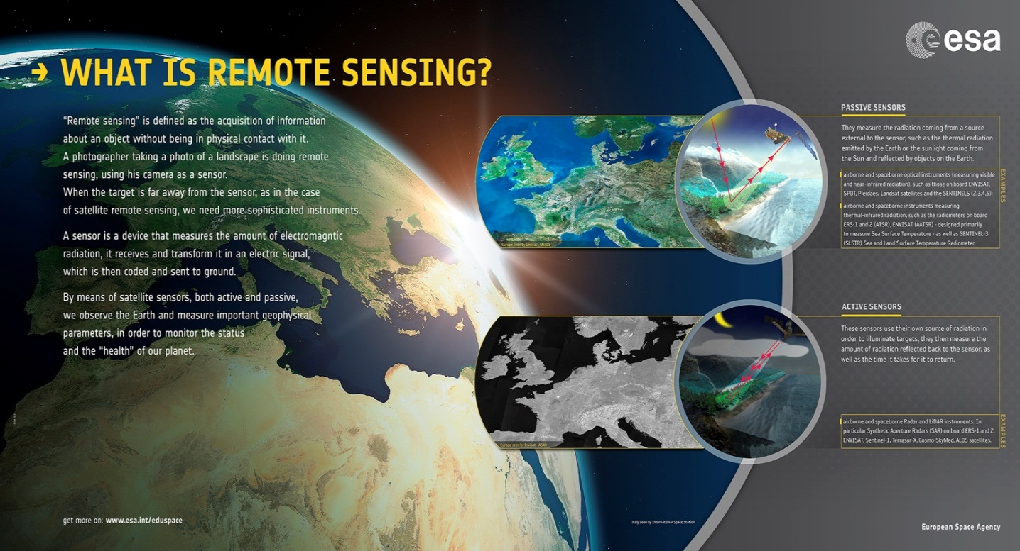
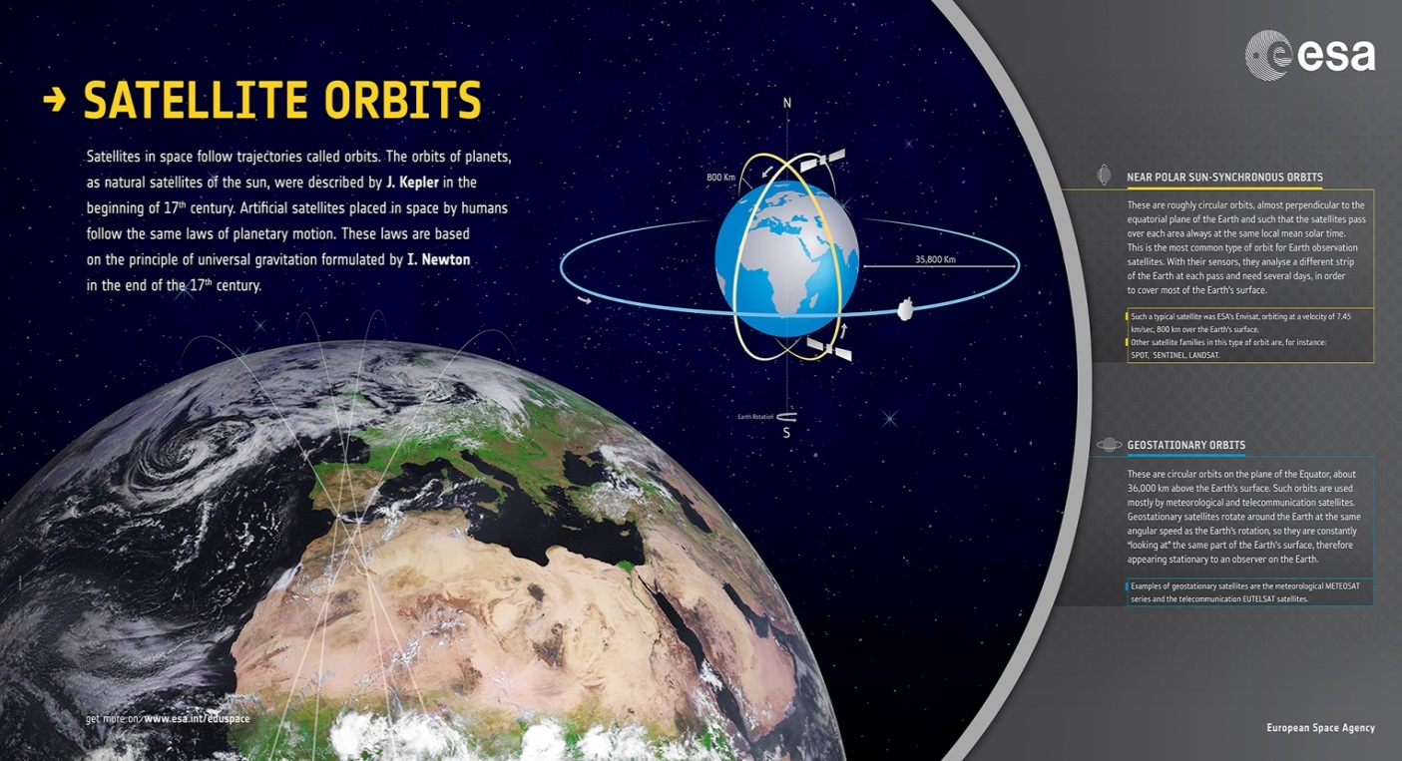
Creation of posters for schools
Posters available in various languages (English, German, Spanish, Czech and Greek)
What is Remote Sensing?
Satellite orbits
Ocean applications
Land applications
Ice applications
Atmosphere applications

Slide 35
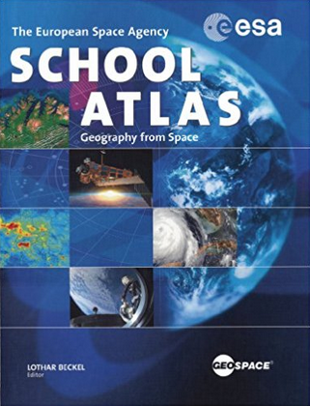
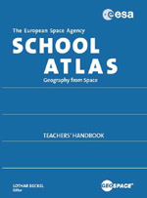

ESA School Atlas, new ESA Water Atlas
Introduction to ESA; Earth Observation; Global Overview; Continental Overview; the Natural Sphere; The Cultural Sphere.
Annex: Teachers’ Handbook, DVD-ROMs with the original bands of the satellite data, handbook content and exercises, connected to Eduspace and its SW Leoworks
Describes the major issues related to water on Earth. It also presents water as a natural resource, focusing on global water, the oceans, seas, lakes and rivers of the Earth.
Both freely available in
PDF from ESA web pages (https://earth.esa.int/web/guest/eo-education-and-training)

Slide 36
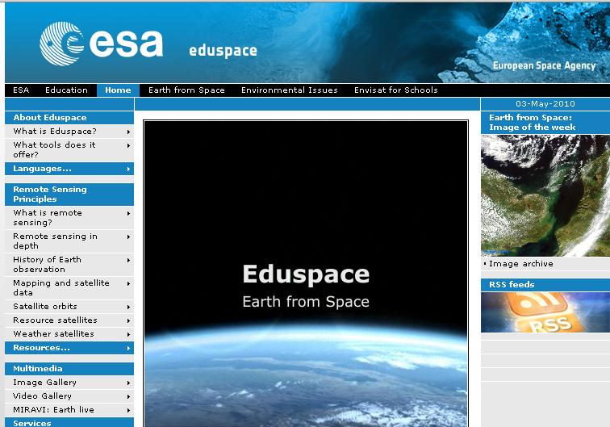
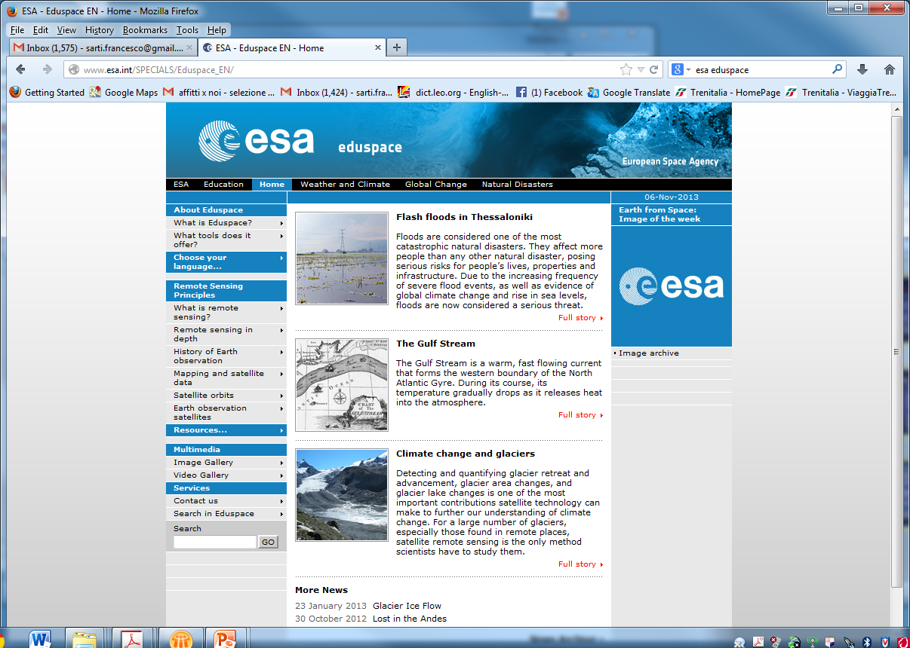
Eduspace: ESA web-based EO Educational tool for secondary schools

Slide 37
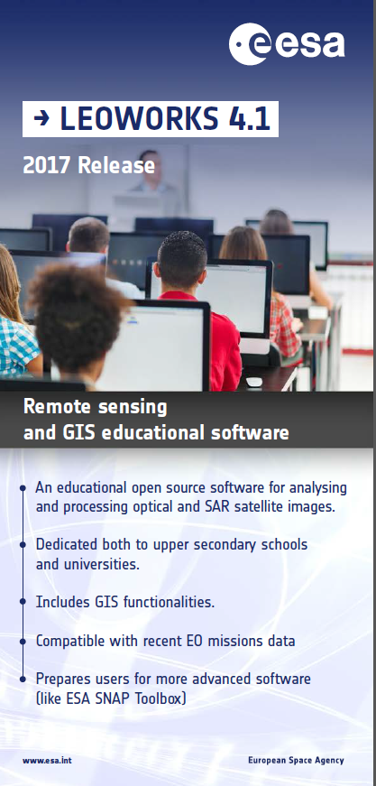
LEOWorks 4.1
Image Processing Software
NEW release
View images, histogram, pixel values, header info
Crop, invert, stretch, layer stack, etc
Image arithmetic, filters
Classification, PCA, geometric correction, pan sharpening
Radar and optical module (multimission, including Sentinel data)
GIS tools
Open-source, Java-based

Slide 38
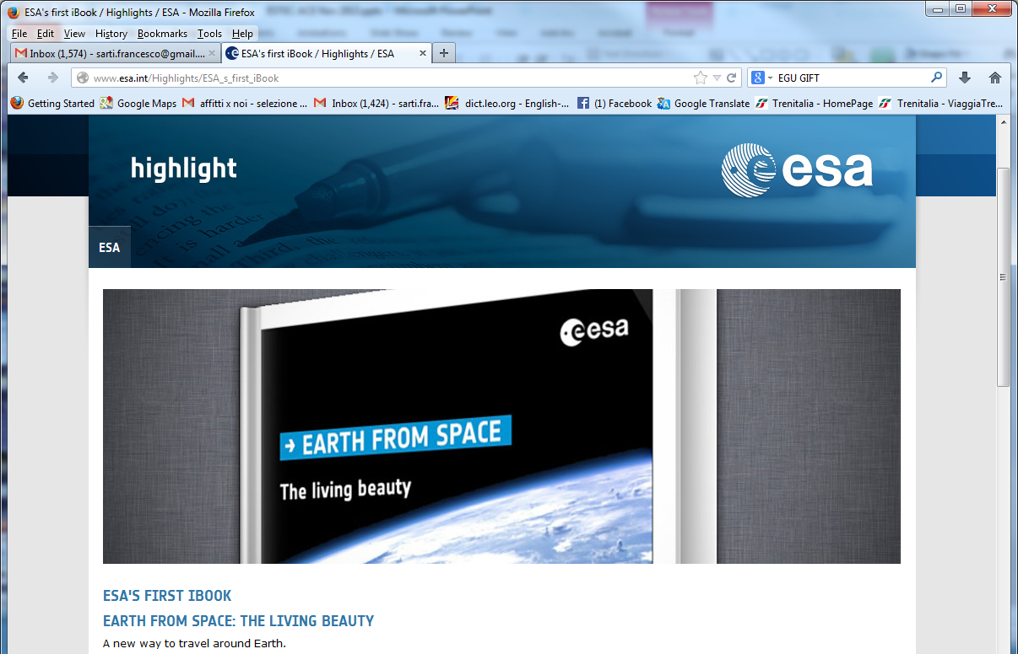
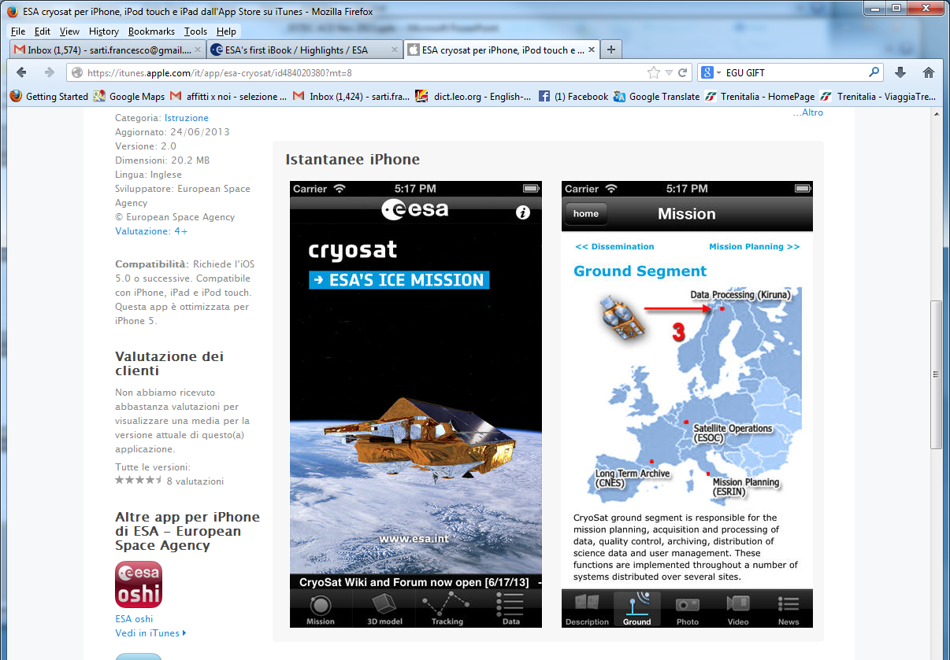
I-books, Apps

Slide 39
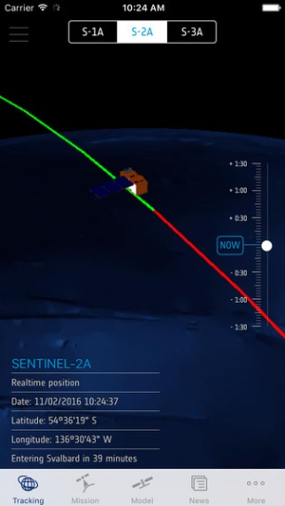





Sentinel App
For iPhone
See where the Sentinel satellites are in real-time
See the last and next time they have been and will be over your location; Move them to the time of the last data transmission and smoothly move them back to their current location over the 3D globe
Explore the Sentinel satellite 3D models
Get information and news about the Copernicus Programme
Get information about access to Sentinel data
Set Notifications to be warned when satellites are flying by
Stay tuned with the latest mission information

Slide 40






Proba-V App
Take a picture of a landscape
Associate the vegetation status derived from Proba-V NDVI products in your area to the picture
See graphics of the vegetation status evolution during the last 6 months (tap on picture icon or on map)
Build your picture gallery and see all your pictures on the map
Share the pictures on social media
Learn about Proba-V, get news and image of the week
UI available in several languages: English, Italian, Portuguese, Dutch, Spanish, German, etc.

Slide 41
Proba-V App
NEW release soon
additional vegetation indices: Leaf Area Index (LAI), Dry Matter Productivity (DMP) and the Land Surface Temperature (LST)
visualization of NDVI, LAI, Corine land cover and Natura 2000 layers
description about each Natura 2000 area and its fauna
notification if the user is near a Natura 2000 area
social media photo sharing (Facebook, Twitter and Instagram)

Slide 42




Prototype Apps (not online)
EDUCATIONAL App
PDGS App
NRT App
Presentation tool
support to school or educational labs
EO satellite images within 1 minute from acquisition on the palm of your hand!
Alerts when satellite is passing over you
Landsat-8 OLI data available
Tool to learn about the Lifecycle of an EO Mission, from User Needs Definition, to Planning, Acquisition, Archiving, Dissemination and Exploitation

Slide 43



Educational App for EO
For iOS tablets (iPad, iPad mini)
Can be used as presentation tool and as support to school or educational labs/classes
Not on online stores at the moment

Slide 44



EO Missions (PDGS) App
For iOS tablets (iPad, iPad mini)
Used for ESRIN visits, not planned for online stores
Learn about the Lifecycle of an EO Mission, from User Needs Definition, to Planning, Acquisition, Archiving, Dissemination and Exploitation

Slide 45


NRT Image Viewing App
For Android Tablets
Planned to be on Google Play in the next few months
EO satellite images within 1 minute from acquisition on the palm of your hand!
Move easily between past acquisitions
Receive alerts when satellite is passing over you
Landsat-8 OLI data available. Sentinel-2, Proba-V coming soon

Slide 46

CCI App & visualisation tool
Climate from Space, ESA's iPad App for visualization of climate data being produced through the European Space Agency's Climate Change Initiative (CCI)
Allows to visualize temporal changes of:
sea surface temperature,
the ice sheets,
sea level,
sea ice,
carbon dioxide,
soil moisture and many more.

Slide 47



Educational stories / exercises on Climate Change
Set of thematic stories and hands-on exercises based on the CCI Visualisation Tool (Climate from Space) or CCI App
Dedicated to secondary school students
Tutorials for teachers
Not online, still under review

Slide 48
Video courses (University level) about EO
ESA recently started to create educational MOOCs for EO techniques &
Applications, starting with Climate Change
What is a MOOC?
Massive: no limitation on the number of participants. The record is 440,000!
Open: free and accessible for anyone with an Internet connection
Online: all activities are made online
Course: it has a specific topic, prepared by specialists, offering theoretical and practical content

Slide 49



MOOC Climate from Space (Future Learn)
https://www.futurelearn.com/courses/climate-from-space
10,000+ subscriptions, 50% active, completion rate of 30% (very high!)
MOOC 5-weeks course (June, 2015 / Dec, 2015) included videos, text, quiz, interactive exercises, satellite tracking app
Interactive, with Q&A. Two editions done, more will follow

Slide 50

Other ESA MOOCs
3rd ESA MOOC on Climate from Space “Greenland special” (in two months)
https://www.futurelearn.com/courses/climate-from-space
1st ESA MOOC “EO from Space: The Optical View”
https://www.futurelearn.com/courses/optical-earth-observation
1st ESA MOOC “EO from Space: The Radar View” Foreseen launch in October 2017

Slide 51


SAR video lectures and
SNAP tutorials (French)
SAR basic theory and practical exercises with SNAP (French version)
Subtitles (Spanish, English) done for free by students, not online but available ….

Slide 52

SNAP tutorials and forum
Set of tutorials for SNAP
( Sentinel toolboxes) http://step.esa.int/main/doc/tutorials/
User forum dedicated to
Sentinel toolboxes (SNAP)
http://forum.step.esa.int/

Slide 53







ESA Thematic Exploitation Platforms
→ FOOD SECURITY TEP
Thematic Exploitation Platforms are open virtual collaborative environments bringing together EO and non-EO data, hosted processing services, collaborative tools and algorithm development tools
http://tep.eo.esa.int
tepcoreteam@esa.int
Notes:
The TEPs

Slide 54
CB about EO Data Access

Slide 55
Status of EO missions
Sentinel-1 (1A launched on 3/04/2014; 1B on 25/04/2016)
Sentinel-2 (2A launched on 23/06/2015; 2B on 7/03/2017)
Sentinel-3 (3A launched on 16/02/2016; 3B to be launched in 2017)
Sentinel-4 (launch planned for 2019)
Sentinel-5 (launch planned for 2021)
Sentinel-5P (launch planned for August 2017)
Sentinel-6 (launch planned for 2020)
SMOS – still operating (until 2017)
CryoSAT
SWARM
ADM-Aeolus (launch planned for the end 2017)
EarthCARE (launch planned for 2018)
BIOMASS (launch planned for 2021)

Slide 56

EO Data Access - Copernicus
Sentinel data – freely available from dedicated hubs e.g. https://scihub.copernicus.eu/dhus/#/home

Slide 57

EO Data Access - Copernicus
ESA has provided specific training in 2016 in Madagascar about Data Access, with SW tools facilitating download of image tiles
The Data Hub Software (DHuS) is open source software supporting the ESA Copernicus data access.
It provides a simple web interface to allow interactive data download
http://sentineldatahub.github.io/DataHubSystem/index.html

Slide 58


EO Data Access - Copernicus
CORE Datasets - continuous data delivery from systematic missions or generation of large predefined coverages. Defined user eligibility, and specific to each dataset, is defined in the Access Rights access to the data is via subscription.

Slide 59

EO Data Access - Copernicus
Additional Datasets – very high resolution SAR and optical data (archive and new acquisitions), eligible users are granted by EC and may order data

Slide 60

EO Data Access – ESA Missions
Access to ESA free, online datasets through 'My EarthOnline' fast registration (https://earth.esa.int/web/guest/data-access)
ERS-1, ERS-2, Envisat, GOCE, SMOS, CryoSat, SWARM
Mission Exploitation
Platforms (Proba-V)

Slide 61
Impact evaluation and improvement
Continuous improvement from online feedback collection after each course
Evaluation of impact for other educational tools (videos, apps, etc.) is harder

Slide 62
USEFUL ADDRESSES
ESA education portal: www.esa.int/education
to order EO material: education@esa.int or eohelp@esa.int
Eduspace: http://www.esa.int/SPECIALS/Eduspace_EN/
ESA EO Education web page: https://earth.esa.int/web/guest/eo-education-and-training

Slide 63
The 5th Meeting of the CEOS Working Group on
Capacity Building & Data Democracy (WGCapD-5)
The CEOS Systems Engineering Office (SEO), Hampton, VA, USA
March 30th – April 1st, 2016
Thank you

